Slide 1
Welcome
To our presentation

Slide 2

PRESENTED TO
Rasheduzzaman Khan Suzan
Lecturer
DEPT OF CSE
HABHIT
PRESENTED BY
Jannatul Rahman ( 17 )
Tayeb Ahmed ( 09 )
Fardin Rahman Shamil ( 20 )
DEPT OF CSE
2nd year 3rd Semester
HABHIT

Slide 3
PRESENTED TO
Rasheduzzaman Khan Suzan
Lecturer
DEPT OF CSE
HABHIT
PRESENTED BY
Jannatul Rahman ( 17 )
Tayeb Ahmed ( 09 )
Fardin Rahman Shamil ( 20 )
DEPT OF CSE
2nd year 3rd Semester
HABHIT

Slide 4
Data Structure

Slide 5
Objective
What is data & data structure
Classification of data structure
Primitive data structure
Non Primitive data structure
Description of various Linear data structure
Description of various Non – Linear data structure
Commonly used operations on data structure
Why Data Structure is significant in Computer Science
Some applications of Data Structure

Slide 6
What is Data & Data Structure ?
Data :
Data are single value or sets of values.
A representation of facts, concepts or instructions in a formalized manner suitable for communication, interpretation or processing by human or automatic means is called data.
Example: Name, Age, Date, Time etc.

Slide 7
What is data & Data Structure ?
Data Structure :
A data structure is a specialized format for organizing, processing, retrieving and storing data.
In computer programming a data structure may be selected or designed to store data for the purpose of working on it with various algorithms.

Slide 8
Classification of Data Structure
Data Structure
Primitive
Non Primitive
Integer
Float
Character
Pointer
Linear
Non Linear
Static
Dynamic
Tree
Graph
Array
Linked List
Stack
Queue

Slide 9
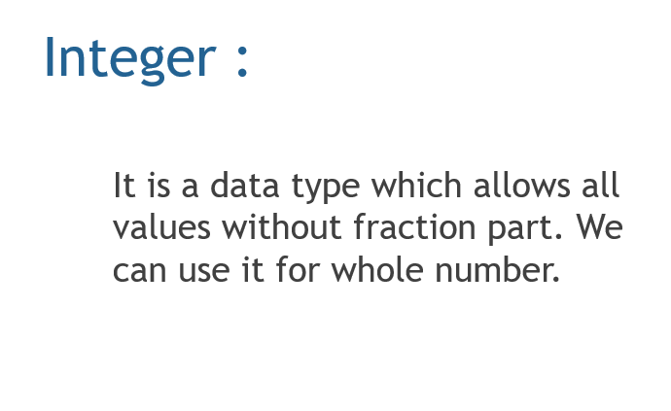
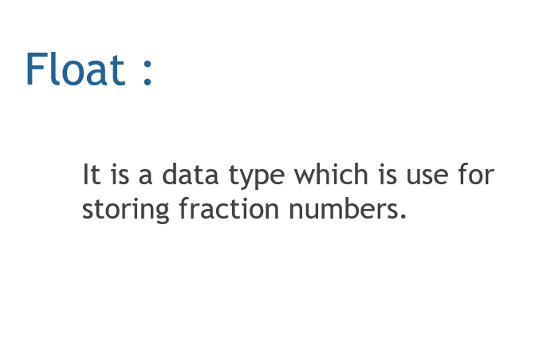
Primitive Data Structure
Primitive data structure is basic structure and directly operated upon by machine instructions.
Integers, floats, characters and pointers are example of primitive data structure.

Slide 10
Primitive Data Structure
Character :
It is a data type for using
character values.
Pointer :
A variable that hold memory
address of another variable is
called pointer.

Slide 11
Non Primitive Data Structure
The data structure that is derived from the primitive data structure are called Non-primitive data structure.
The Non-primitive data structure emphasize on structuring of a group of homogeneous ( same type ) or heterogeneous ( different type ) data items.

Slide 12
Linear Data Structure
A linear data structure simply mean that it is a storage format of the data in the memory in which the data are arranged in contiguous blocks of memory.
In the linear data structure, member elements form a sequence in the storage.
Example :- Array, Stack, Queue & Linked list

Slide 13
Description of various Linear Data Structure
Arrays :
An array is defined as a set of finite number of homogeneous elements or same data.
Syntax : Datatype Array-name [ Size ]
Types of Array :
Single Dimensional Array
Array with one subscript
Two Dimensional Array
Array with two subscript
Multi Dimensional Array
Array with multiple subscript

Slide 14
Description of various Linear Data Structure
Memory Allocation of Array :
Base Address
100
104
108
112
116
arr [0]
arr [1]
arr [2]
arr [3]
arr [4]
int arr [5]

Slide 15
Description of various Linear Data Structure
Stack :
Stack is a data structure in which insertion and deletion operation performed at one end only.
Insertion of element into stack is called “PUSH”
Deletion of element into stack is called “POP”
Stack is also known as Last In First Out ( LIFO ) data structure.

Slide 16
Description of various Linear Data Structure
Queue :
The data structure which permits the insertion at one and deletion at another end known as Queue.
Queue is also called First In First Out ( FIFO ) data structure.

Slide 17
Description of various Linear Data Structure
A common example of Queue :

Slide 18
Description of various Linear Data Structure
Linked List :
A linked list can be defined as a collection of variable number of data called “Nodes”
Lists are the most commonly used non-primitive data structure.
Each nodes divided into two parts :
The first part contains the information of the element.
The second part contains the memory address of the next node in the list. Also called Link part.

Slide 19
Non Linear Data Structure
Non linear data structures are those where data items are not arranged in a sequential manner, unlike linear data structure.
In these data structures, elements are stored in a hierarchical or a network based structure that does not follow a sequential order.
Example :- Tree & Graph

Slide 20
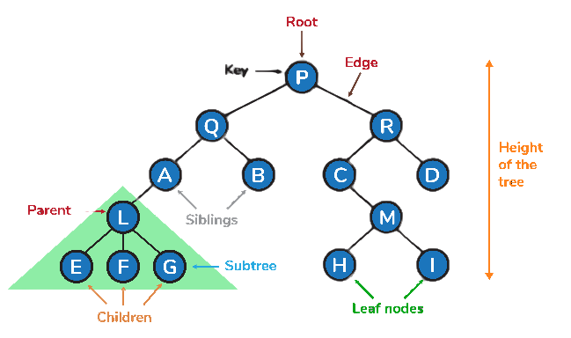
Description of Non Linear Data Structure
Tree :
A tree is a non linear data structure made up of nodes or vertices and edges without having any cycle.
The tree with no nodes is called the null or empty tree.
One node is distinguished as a root.
A tree that is not empty consists of a root node and potentially many levels of additional nodes that form a hierarchy.

Slide 21
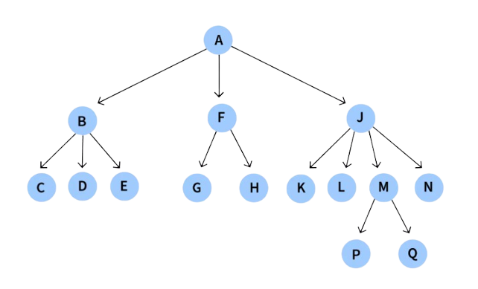
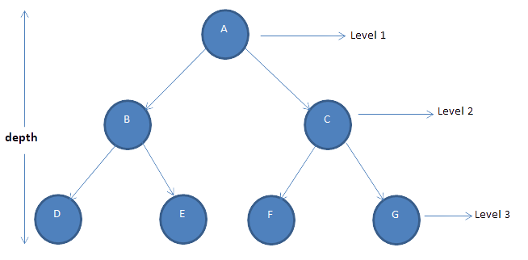
Description of Non Linear Data Structure
Example of Tree :
General Tree
Binary Tree
General Tree
Binary Tree

Slide 22
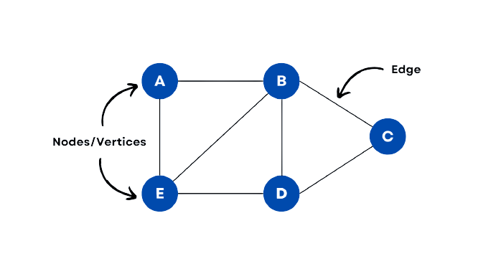
Description of Non Linear Data Structure
Graph :
Graph is a mathematical non-linear data structure capable of representing many kind of physical structures.
A graph has a set of vertices and edges which connect them.

Slide 23
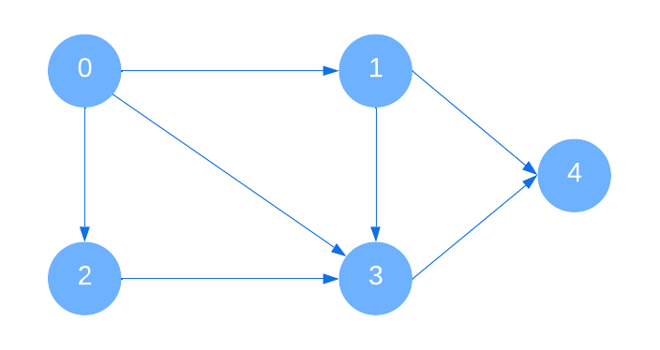
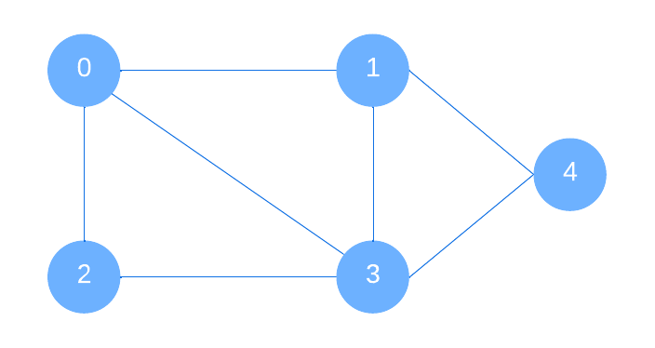
Description of Non Linear Data Structure
Example of Graph :
Directed Graph
Undirected Graph
Directed Graph
Undirected Graph

Slide 24
Commonly Used Operations On Data Structure
Create
Selection
Updating
Traversal
Insertion
Searching
Sorting
Merging
Destroy or Delete

Slide 25
Why Data Structure is Significant in Computer Science ?
Data structure allow to store the information on hard disk.
An appropriate choice of ADT (Abstract Data Type) makes program more efficient.
Data structures are necessary for designing efficient algorithms.
It provides reusability and abstraction.
Manipulation of large amounts of data is easier.

Slide 26
Some Applications of Data Structure
Organization of data in a computer’s memory.
Representation of information in database.
Algorithms that search through data .(such as a search engine)
Software that manages files and directories. (such as a file manager)
Algorithms that encrypt & decrypt data. (such as a security system)
Software that renders graphics. (such as 3D rendering software)

Slide 27
Thanks For Watching

